Slide 1
The Empirics of Firm Heterogeneity Summer School in Economics - Montevideo
Peter K. Schott Yale School of Management & NBER

Slide 2









My Family Tree
Bob Stern Michigan
Peter Hooper Deutsche Bank
J David Richardson
Syracuse
Ed Leamer UCLA
Bob Staiger Wisconsin
Keith Maskus Colorado
ME
Harry Bowen ?
Dan Trefler Toronto
James Harrigan NY Fed
Kishore Gawande Texas A&M

Slide 3
The Approach I Inherited
Questions (Issues)
Is this the best story for answering our question?
What kind of evidence can we bring to bear on this question?
Theory (Stories)
Evidence (Data)
Does the story make sense?

Slide 4
Overview
Research in international trade has been transformed by the growing availability of microdata
Firms and plants
International trade transactions
Matched employer-employee data
These data have inspired a wide range of new models
Entry into export markets
Optimal firm scope
Product/process upgrading and technology adoption
In/outsourcing and on/offshoring
Management hierarchies
Intermediation

Slide 5
Outline
Microdata’s “challenge” to traditional trade models
Models developed to meet these challenges
Recent empirical work

Slide 6
Traditional Trade Theory
Traditional trade theory focused on countries and industries
Why?
No data on firms!

Slide 7
Traditional Inter-Industry Trade Ricardo, HO
United States
Chemicals
Apparel
China
Key Prediction
Countries export their comparative advantage industry and import their comparative disadvantage industry
Implicitly: any (all?) firms that export should be in the comparative advantage industry

Slide 8
Traditional Intra-Industry Trade Krugman
Ford
United States
Germany
VW
Key Prediction
Increasing returns to scale and love of variety are the basis for trade
All firms are the same, so they either all export (free trade) or none export (autarky)

Slide 9
Micro-data Challenges to Traditional Trade Theory
Micro-data tracking firm production and trade started becoming available to researchers in the late 1990s
“Stylized” facts emerging from these datasets challenged the predictions of traditional trade models

Slide 10
Micro-data Challenges to Traditional Trade Theory
Challenge 1: Firm Heterogeneity and Excess Reallocation
Challenge 2: Exporters vs Non-Exporters
Challenge 3: Exporting and Firm Performance
Challenge 4: Trade Liberalization, Reallocation and Productivity

Slide 11
Micro-data Challenges to Traditional Trade Theory
Challenge 1: Firm Heterogeneity and Excess Reallocation
Challenge 2: Exporters vs Non-Exporters
Challenge 3: Exporting and Firm Performance
Challenge 4: Trade Liberalization, Reallocation and Productivity

Slide 12
Heterogeneity and Excess Reallocation Challenges from Micro Data #1
There is vast heterogeneity in plant and firm attributes, even within narrow industries
Indeed, heterogeneity within industries can be as large as heterogeneity across industries

Slide 13
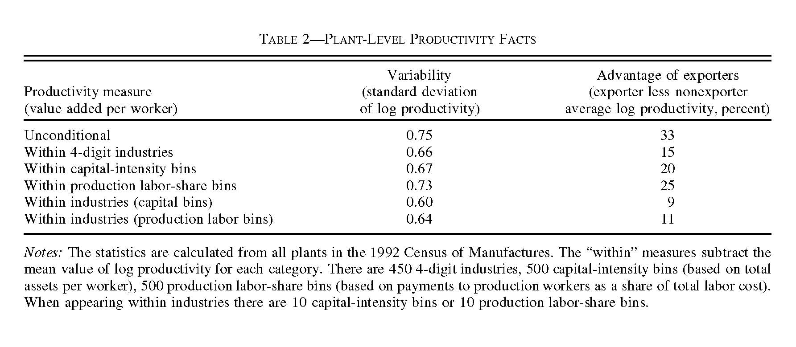
Plant Heterogeneity Bernard, Eaton, Jensen and Kortum 2003

Slide 14
Heterogeneity and Excess Reallocation Challenges from Micro Data #1
There is vast heterogeneity in plant and firm attributes, even within narrow industries
Heterogeneity within industries can be as large as heterogeneity across industries
There is ongoing firm entry and exit and job creation and job destruction in all industries, even when “policy” is “constant”

Slide 15
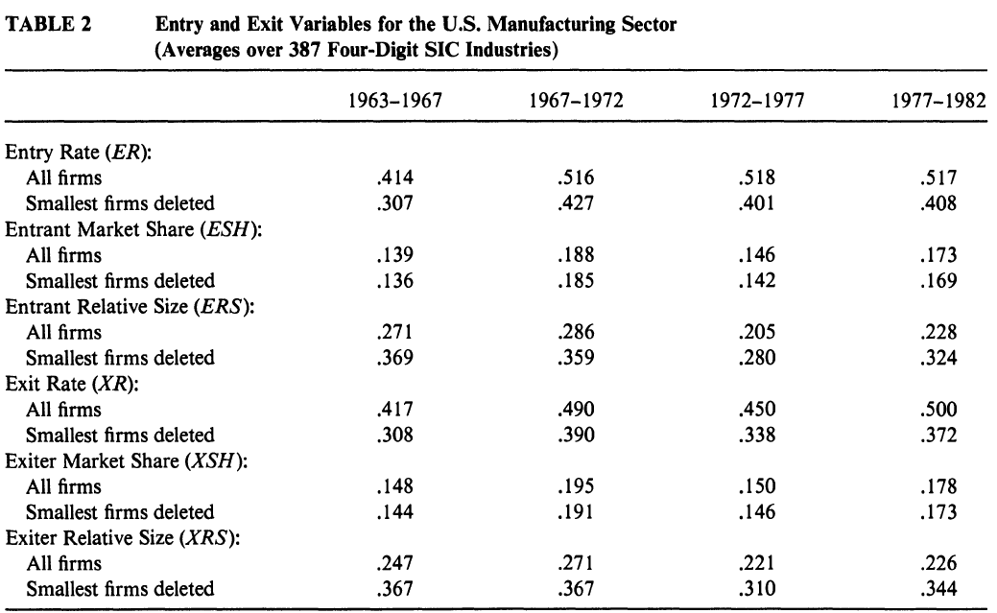
Firm Entry and Exit Dunne, Roberts and Samuelson 1988

Slide 16
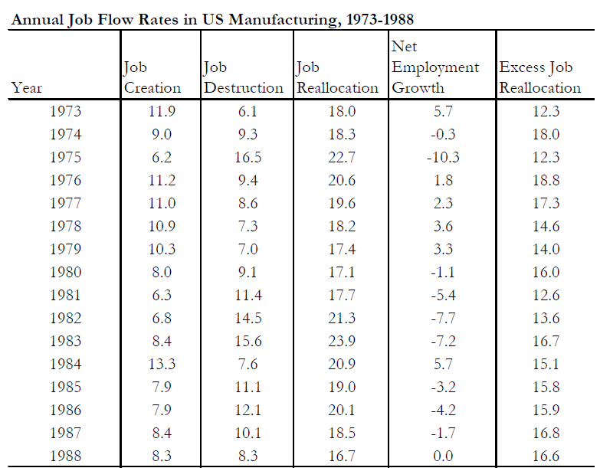
Job Reallocation Davis, Haltiwanger and Schuh 1996
+
=

Slide 17
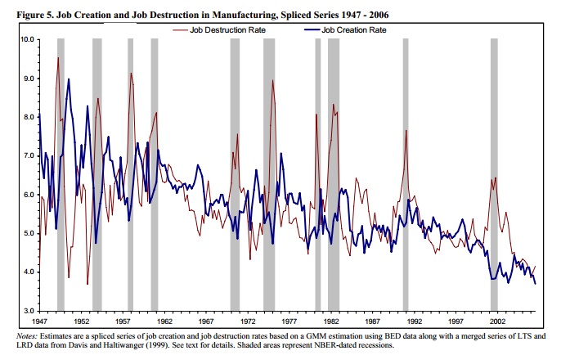
Job Reallocation Faberman 2008

Slide 18
Heterogeneity and Excess Reallocation Challenges from Micro Data #1
There is vast heterogeneity in plant and firm attributes, even within narrow industries
Heterogeneity within industries can be as large as heterogeneity across industries
There is ongoing firm entry and exit and job creation and job destruction in all industries, even when “policy” is constant
When policy changes do take place, a substantial share of observed reallocation occurs across firms within industries (e.g., Levinsohn 1999)
We’ll come back to this…

Slide 19
Challenges to Traditional Trade Theory
Challenge 1: Heterogeneity and Excess Reallocation
Challenge 2: Exporters vs Non-Exporters
Challenge 3: Exporting and Firm Performance
Challenge 4: Trade Liberalization, Reallocation and Productivity

Slide 20
Exporters versus Non-Exporters Challenges from Micro Data #2
Exporters are rare

Slide 21
Exporting is Rare Bernard, Jensen, Redding and Schott 2007
 | United States, 2000
 | Firms | %All Firms
All Firms | 5,474,639 | 100
Source: Bernard et al (2007).

Slide 22
Exporting is Rare Bernard, Jensen, Redding and Schott 2007
 | United States, 2000
 | Firms | %All Firms
All Firms | 5,474,639 | 100
Exporters | 167,217 | 3.1
Source: Bernard et al (2007).

Slide 23
Exporting is Rare Bernard, Jensen, Redding and Schott 2007
 | United States, 2000
 | Firms | %All Firms
All Firms | 5,474,639 | 100
Exporters | 167,217 | 3.1
All Manufacturing Firms | 405,123 | 7.4
Source: Bernard et al (2007).

Slide 24
Exporting is Rare Bernard, Jensen, Redding and Schott 2007
 | United States, 2000
 | Firms | %All Firms
All Firms | 5,474,639 | 100
Exporters | 167,217 | 3.1
All Manufacturing Firms | 405,123 | 7.4
Exporters | 60,321 | 1.1
Source: Bernard et al (2007).

Slide 25
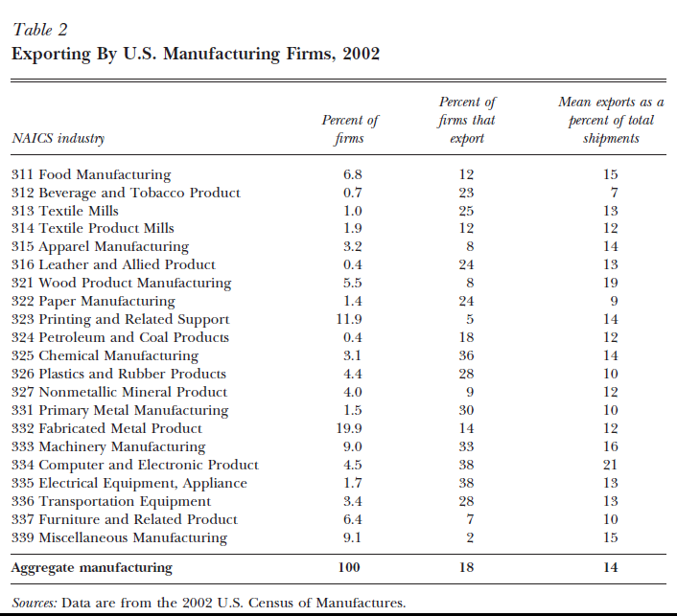
Exporting is Rare, but Happens in All Industries Bernard, Jensen, Redding and Schott 2007
Exporting is more likely in some industries…
But it occurs in all industries

Slide 26
Exporters versus Non-Exporters Challenges from Micro Data #2
Exporters are rare
Exporting is not random

Slide 27
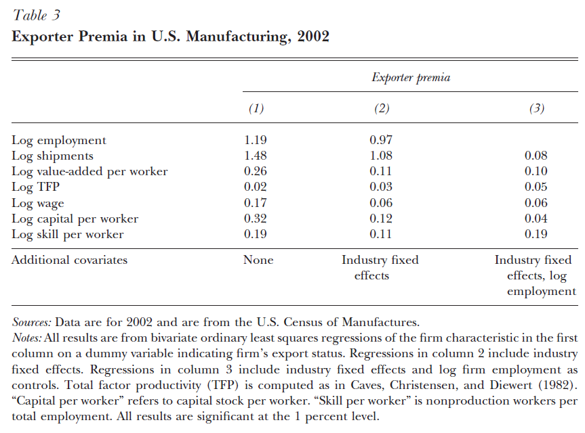
Exporters are Different Bernard, Jensen, Redding and Schott 2007
While it makes sense that US exporters are capital and skill intensive, similar gaps are found among firms in labor-abundant countries
May reflect sorting by quality (e.g., Harrigan and Resheff 2011)

Slide 28
By the Way, Importers are also Rare, Different
The early trade literature using micro data concentrated on firm exporting for reasons of data availability
Subsequent data reveal that importing is rare and that importers are different
How might the literature – and policy?? – have developed if early datasets tracked importing rather than exporting?

Slide 29
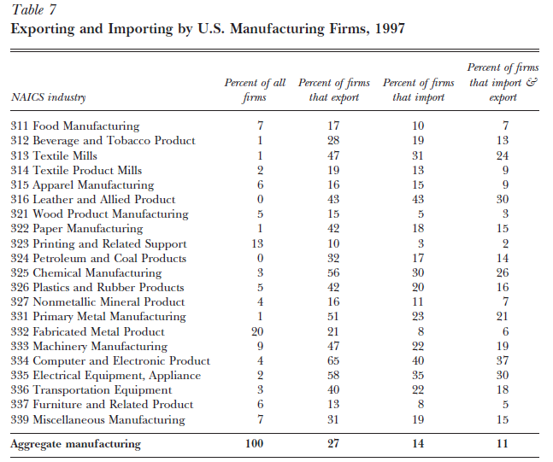
Importers are Rare Too Bernard, Jensen, Redding and Schott 2007

Slide 30
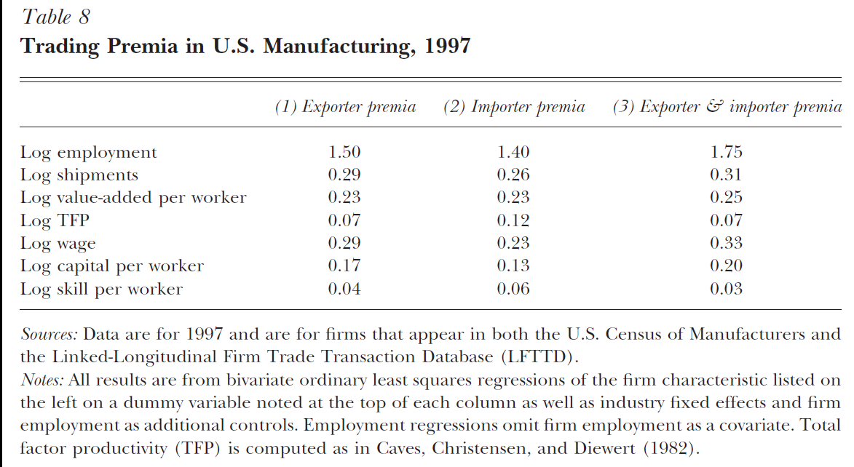
Importers are Different Too Bernard, Jensen, Redding and Schott 2007

Slide 31
By the Way, Importers are also Different
The early trade literature using micro data concentrated on firm exporting for reasons of data availability
Subsequent data reveal that importing is rare and that importers are different
Multinational firms are larger and more productive than firms that only serve the domestic market
E.g., Doms and Jensen (1998)

Slide 32
Challenges to Traditional Trade Theory
Challenge 1: Heterogeneity and Excess Reallocation
Challenge 2: Exporters vs Non-Exporters
Challenge 3: Exporting and Firm Performance
Challenge 4: Trade Liberalization, Reallocation and Productivity

Slide 33
Exporting and Firm Performance Challenges from Micro Data #3
Exporters are more productive, but which way does the causality run?
Productivity g Exporting
or
Productivity f Exporting

Slide 34
Exporting and Firm Performance Challenges from Micro Data #3
There is strong evidence that good firm performance leads to exporting (“self-selection” of the most productive firms)
US: Bernard and Jenson (1999)
Taiwan: Aw, Chen and Roberts (2001)
Evidence for whether exporting leads to good firm performance (“learning by exporting”) is mixed
Little evidence for Columbia, Mexico and Morocco: Clerides, Lach and Tybout (1998)
Some evidence for other developing countries: Van Biesebroeck (2005)
Related research suggests exporting may increase the return to complementary investments such as technology adoption
Theory: e.g., Atkeson and Burstein (2010)
Data: Bustos (2011), Lileeva and Trefler (2010), Aw et al. (2011)

Slide 35
Exporting and Firm Performance Challenges from Micro Data #3
What other approaches can be used?
Experiments…a new trade frontier

Slide 36
Challenges to Traditional Trade Theory
Challenge 1: Heterogeneity and Excess Reallocation
Challenge 2: Exporters vs Non-Exporters
Challenge 3: Exporting and Firm Performance
Challenge 4: Trade Liberalization, Reallocation and Productivity

Slide 37
Trade Liberalization and Reallocation Challenges from Micro Data #4
In traditional trade models, trade liberalization caused countries to abandon one set of industries in favor of another
U.S. drops apparel, adds more chemicals
Micro-data show that an important effect of trade liberalization is reallocation across firms within industries as well as reallocation across industries

Slide 38


The Chilean Liberalization of the 1970-80s Pavcnik 2002
During the late 1970s and early 1980s, Chile underwent a substantial trade liberalization
Non-tariff barriers eliminated
Tariffs reduced from 100% down to 10%
Overall productivity grew 19% from 1979-1986
6.6% from increased productivity within plants
12.7% from reallocation of resources from less to more efficient producers
Tybout (2003) finds a similar pattern of results in a large number of studies focused on developing economies

Slide 39
Trade Liberalization and Reallocation Challenges from Micro Data #4
One concern in identifying the reallocation effects of trade liberalization is that it often occurs as part of a broader package of reforms
However, research into the effects of narrower liberalizations, such as the Canada-US Free Trade Agreement, find similar effects
E.g., Trefler (2004)…

Slide 40
The Canada-US Free Trade Agreement Trefler 2004
Before the Canada-US free trade agreement went into effect in 1989, more than one in four Canadian industries were protected by tariffs of more than 10 percent
Trefler (2004) finds that when tariffs fell, industry productivity rose more than twice as much as plant productivity, implying reallocation towards more productive plants
“The idea that an international trade policy could raise labor productivity so dramatically is, to my mind, remarkable.”

Slide 41
Challenges to Traditional Trade Theory
Challenge 1: Heterogeneity and Excess Reallocation
Challenge 2: Exporters vs Non-Exporters
Challenge 3: Exporting and Firm Performance
Challenge 4: Trade Liberalization and Reallocation
Need more than “old” and “new” trade theory

Slide 42
Challenges to Traditional Trade Theory
Challenge 1: Heterogeneity and Excess Reallocation
Challenge 2: Exporters vs Non-Exporters
Challenge 3: Exporting and Firm Performance
Challenge 4: Trade Liberalization and Reallocation
Need more than “old” and “new” trade theory; need new “new” trade theory

Slide 43
Outline
Microdata’s challenge to traditional trade models
Models developed to meet these challenges
Recent model- and dataset-driven empirical work

Slide 44

Rationalizing the Empirical Challenges
Several models of firm heterogeneity have been developed to capture the empirical regularities discussed on the previous slides
Of these, the overwhelming favorite so far is the is the Melitz model, which embeds firm heterogeneity into the Krugman (1980) model illustrated earlier

Slide 45
The Basic Features of Melitz (2003)
Firms use labor to produce varieties of a manufacturing good
Firms enter a market by paying a sunk entry cost
Firms observe their productivity ϕ from a distribution g(ϕ) and keep this productivity their whole life
There is a fixed cost of producing and a fixed cost of exporting
Firms decide whether to produce or exit the industry based on ϕ: do they earn the profit needed to cover the fixed costs
If produce, also decide whether to export
Firms face an exogenous probability of death, in which case they are replaced by entry from the fringe

Slide 46
Visualizing Melitz
Firms receive a productivity draw after paying an sunk cost of entry
Exit Immediately
Successful Entry
Productivity Draw

Slide 47
Visualizing Melitz
Firms pay a fixed cost to enter the export market
Exit Immediately
Domestic Only
Successful Entry
Domestic & Export
Productivity Draw

Slide 48
Visualizing a Melitz Trade Liberalization
Imagine trade costs fall
Exporting becomes more profitable
Minimum level of productivity needed to export falls, inducing entry into the export market
But competition from entrants trying to get that profit raises the minimum level of productivity needed to survive, causing the least productive firms to exit
Exit Immediately
Domestic Only
Domestic & Export
Productivity Draw

Slide 49
Updated View of the Gains From Trade Liberalization
Ricardo/HO
Gains from specialization and trade according to comparative advantage
Krugman
Consumers get more variety and benefit from greater economies of scale
Melitz
Weak are firms driven from the market, so industry productivity rises

Slide 50
The Influence of the Melitz Model
The Melitz model has been used and extended in countless directions
Examples
Melitz + variable markups: Melitz and Ottaviano (2008)
Melitz + asymmetric countries: Arkolakis et al. (2008)
Melitz + firm boundaries: Antras and Helpman (2004, 2008)
Melitz + management hierarchies: Caliendo and Rossi-Hansberg (2011)
Melitz + Heckscher-Ohlin: Bernard et al. (2007)

Slide 51
The Influence of the Melitz Model
The Melitz model has been used and extended in countless directions
Examples
Melitz + variable markups: Melitz and Ottaviano (2008)
Melitz + asymmetric countries: Arkolakis et al. (2008)
Melitz + firm boundaries: Antras and Helpman (2004, 2008)
Melitz + management hierarchies: Caliendo and Rossi-Hansberg (2011)
Melitz + Heckscher-Ohlin: Bernard et al. (2007)

Slide 52
Exporting is Rarer in Some Industries than Others Bernard, Redding and Schott 2007
Exporting by US Manufacturing Plants
NAICS Industry |  | Percent of All Plants | Percent of Plants that Export | Mean Capital Intensity ($000) | Mean Skill Intensity (%)
311 | Food Manufacturing | 8 | 15 | 87 | 33
312 | Beverage and Tobacco Product | 1 | 21 | 183 | 48
313 | Textile Mills | 1 | 27 | 92 | 21
314 | Textile Product Mills | 2 | 14 | 25 | 25
315 | Apparel Manufacturing | 3 | 8 | 16 | 21
316 | Leather and Allied Product | 0 | 24 | 23 | 23
321 | Wood Product Manufacturing | 5 | 10 | 58 | 20
322 | Paper Manufacturing | 2 | 28 | 142 | 26
323 | Printing and Related Support | 10 | 6 | 47 | 31
324 | Petroleum and Coal Products | 1 | 12 | 357 | 28
325 | Chemical Manufacturing | 4 | 35 | 322 | 39
326 | Plastics and Rubber Products | 5 | 30 | 78 | 24
327 | Nonmetallic Mineral Product | 6 | 9 | 113 | 23
331 | Primary Metal Manufacturing | 2 | 33 | 121 | 24
332 | Fabricated Metal Product | 18 | 16 | 56 | 27
333 | Machinery Manufacturing | 9 | 36 | 59 | 36
334 | Computer and Electronic Product | 5 | 40 | 64 | 47
335 | Electrical Equipment, Appliance, | 2 | 41 | 55 | 34
336 | Transportation Equipment | 4 | 34 | 71 | 26
337 | Furniture and Related Product | 5 | 8 | 25 | 24
339 | Miscellaneous Manufacturing | 8 | 2 | 32 | 33
Aggregate Manufacturing |  | 100 | 20 | 77 | 29

Slide 53
Melitz + Heckscher-Ohlin Bernard, Redding and Schott 2007
Basic idea: combine two Melitz models
Two countries: one capital-abundant and one labor abundant
Two industries: each contains firms producing horizontally differentiated varieties
Firms within industries vary in terms of their productivity
Key intuition: export opportunities are greater in the comparative advantage industry
Key result: trade liberalization induces greater productivity growth in the comparative advantage industry, magnifying the “old” trade gains
This model can explain
Why some countries export more in certain industries than others
Why, nonetheless, two-way trade is observed within industries
Why, within industries, only some firms export

Slide 54
The Influence of the Melitz Model
The Melitz model has been used and extended in countless directions
Examples
Melitz + variable markups: Melitz and Ottaviano (2008)
Melitz + asymmetric countries: Arkolakis et al. (2008)
Melitz + firm boundaries: Antras and Helpman (2004, 2008)
Melitz + management hierarchies: Caliendo and Ross-Hansberg (2011)
Melitz + Heckscher-Ohlin: Bernard et al. (2007)
…

Slide 55
Outline
Microdata’s challenge to traditional trade models
Models developed to meet these challenges
More recent empirical work

Slide 56
More Recent Empirical Work
Firms are pretty simple in the Melitz model
It leaves out many decisions firms make with respect to
Product range?
Product quality?
Technology adoption and innovation?
Whether to outsource or offshore all or part of production
Managing decision-making?
Hiring workers?
These additional margins can interact with firm decisions about whether to produce and/or trade, and influence aggregate productivity
Notes:
Cites:
Product range (Bernard et al 2010, 2011)
Technology adoption (Constantini and Melitz 2008, De Loecker 2009) and innovation (Atkeson and Burstein 2010)
Whether to onshore or oshore stages of production (Dixit and Grossman 1982, Grossman and Rossi-Hansberg 2008)
Whether to insource or outsource stages of production (Grossman and Helpman 2002, Antras and Helpman 2004)
Firm hierarchies (Antras, Garicano and Rossi-Hansberg 2006, Caliendo and Rossi-Hansberg 2011)
Workforce composition (Helpman, Itskhoki and Redding 2010)

Slide 57
New Empirical Frontiers
Frontier 1: Multiple product firms
Frontier 2: Product quality
Frontier 3: Intermediaries
Frontier 4: Firm export market dynamics

Slide 58
New Empirical Frontiers
Frontier 1: Multiple product firms
Frontier 2: Product quality
Frontier 3: Intermediaries
Frontier 4: Firm export market dynamics

Slide 59
Multiple-Product Firms Empirical Frontier #2
One reason why trade is concentrated among a small number of firms is that larger exporters not only export more per product, they export a greater number of products

Slide 60
Multiple Product Firms Bernard, Jensen, Redding and Schott 2007
Share of Exporting Firms
Number of Products | Number of Countries
 | 1 | 2 | 3 | 4 | 5+ | All
1 | 40.4 | 1.2 | 0.3 | 0.1 | 0.2 | 42.2
2 | 10.4 | 4.7 | 0.8 | 0.3 | 0.4 | 16.4
3 | 4.7 | 2.3 | 1.3 | 0.4 | 0.5 | 9.3
4 | 2.5 | 1.3 | 1.0 | 0.6 | 0.7 | 6.2
5+ | 6.0 | 3.0 | 2.7 | 2.3 | 11.9 | 25.9
All | 64.0 | 12.6 | 6.1 | 3.6 | 13.7 | 100

Slide 61
Multiple Product Firms – US Trade Data Bernard, Jensen, Redding and Schott 2007
Share of Exporting Firms
Number of Products | Number of Countries
 | 1 | 2 | 3 | 4 | 5+ | All
1 | 40.4 | 1.2 | 0.3 | 0.1 | 0.2 | 42.2
2 | 10.4 | 4.7 | 0.8 | 0.3 | 0.4 | 16.4
3 | 4.7 | 2.3 | 1.3 | 0.4 | 0.5 | 9.3
4 | 2.5 | 1.3 | 1.0 | 0.6 | 0.7 | 6.2
5+ | 6.0 | 3.0 | 2.7 | 2.3 | 11.9 | 25.9
All | 64.0 | 12.6 | 6.1 | 3.6 | 13.7 | 100
40% of U.S. exporting firms ship just one product to one country

Slide 62
Multiple Product Firms – US Trade Data Bernard, Jensen, Redding and Schott 2007
Share of Exporting Firms
Number of Products | Number of Countries
 | 1 | 2 | 3 | 4 | 5+ | All
1 | 40.4 | 1.2 | 0.3 | 0.1 | 0.2 | 42.2
2 | 10.4 | 4.7 | 0.8 | 0.3 | 0.4 | 16.4
3 | 4.7 | 2.3 | 1.3 | 0.4 | 0.5 | 9.3
4 | 2.5 | 1.3 | 1.0 | 0.6 | 0.7 | 6.2
5+ | 6.0 | 3.0 | 2.7 | 2.3 | 11.9 | 25.9
All | 64.0 | 12.6 | 6.1 | 3.6 | 13.7 | 100
~75% of U.S. exporting firms ship less than 4 products to less than 4 countries

Slide 63
Multiple Product Firms – US Trade Data Bernard, Jensen, Redding and Schott 2007
Share of Exporting Firms
Number of Products | Number of Countries
 | 1 | 2 | 3 | 4 | 5+ | All
1 | 40.4 | 1.2 | 0.3 | 0.1 | 0.2 | 42.2
2 | 10.4 | 4.7 | 0.8 | 0.3 | 0.4 | 16.4
3 | 4.7 | 2.3 | 1.3 | 0.4 | 0.5 | 9.3
4 | 2.5 | 1.3 | 1.0 | 0.6 | 0.7 | 6.2
5+ | 6.0 | 3.0 | 2.7 | 2.3 | 11.9 | 25.9
All | 64.0 | 12.6 | 6.1 | 3.6 | 13.7 | 100
The 40% of U.S. exporters that export just one product to one country account for just 0.2% of U.S. export value
Share of Export Value
Number of Products | Number of Countries
 | 1 | 2 | 3 | 4 | 5+ | All
1 | 0.20 | 0.06 | 0.02 | 0.02 | 0.07 | 0.4
2 | 0.19 | 0.12 | 0.04 | 0.03 | 0.15 | 0.5
3 | 0.19 | 0.07 | 0.05 | 0.03 | 0.19 | 0.5
4 | 0.12 | 0.08 | 0.08 | 0.04 | 0.27 | 0.6
5+ | 2.63 | 1.23 | 1.02 | 0.89 | 92.2 | 98.0
All | 3.3 | 1.5 | 1.2 | 1.0 | 92.9 | 100
Source: Bernard et al (2007).

Slide 64
Multiple Product Firms – US Trade Data Bernard, Jensen, Redding and Schott 2007
Share of Exporting Firms
Number of Products | Number of Countries
 | 1 | 2 | 3 | 4 | 5+ | All
1 | 40.4 | 1.2 | 0.3 | 0.1 | 0.2 | 42.2
2 | 10.4 | 4.7 | 0.8 | 0.3 | 0.4 | 16.4
3 | 4.7 | 2.3 | 1.3 | 0.4 | 0.5 | 9.3
4 | 2.5 | 1.3 | 1.0 | 0.6 | 0.7 | 6.2
5+ | 6.0 | 3.0 | 2.7 | 2.3 | 11.9 | 25.9
All | 64.0 | 12.6 | 6.1 | 3.6 | 13.7 | 100
The 40% of U.S. exporters that export just one product to one country account for just 0.2% of U.S. export value
But the 12% of firms that export >5 products to >5 countries account for 92% of export value (and ~70% of employment across all exporters)
Share of Export Value
Number of Products | Number of Countries
 | 1 | 2 | 3 | 4 | 5+ | All
1 | 0.20 | 0.06 | 0.02 | 0.02 | 0.07 | 0.4
2 | 0.19 | 0.12 | 0.04 | 0.03 | 0.15 | 0.5
3 | 0.19 | 0.07 | 0.05 | 0.03 | 0.19 | 0.5
4 | 0.12 | 0.08 | 0.08 | 0.04 | 0.27 | 0.6
5+ | 2.63 | 1.23 | 1.02 | 0.89 | 92.2 | 98.0
All | 3.3 | 1.5 | 1.2 | 1.0 | 92.9 | 100
Source: Bernard et al (2007).

Slide 65
Rationalizing Multiple-Product Firms Bernard, Redding and Schott 2011
Start with Melitz, but allow for reallocation within firms
Firms draw
Overall ability
A consumer “taste” for all possible product-destinations
Production entails
Paying a sunk cost to enter
Paying a fixed cost for producing each product in each market
Key results
Higher ability firms generate sufficient profit to supply a wider range of products to a larger set of markets
Trade liberalization: induces firms to drop their weakest products (observed in US during the Canada-US Free Trade Agreement)

Slide 66
Gravity and the Margins of Trade
Modeling multiple-product firms increases our understanding of “gravity”
Decompose countries’ exports into two margins
Intensive: avg firm-product exports conditional on positive trade
Extensive: firm-product observations with positive exports
Further decompose the extensive margin
The number of exporting firms
The number of exported products
The density of trade (fraction of country-product observations with positive trade)

Slide 67
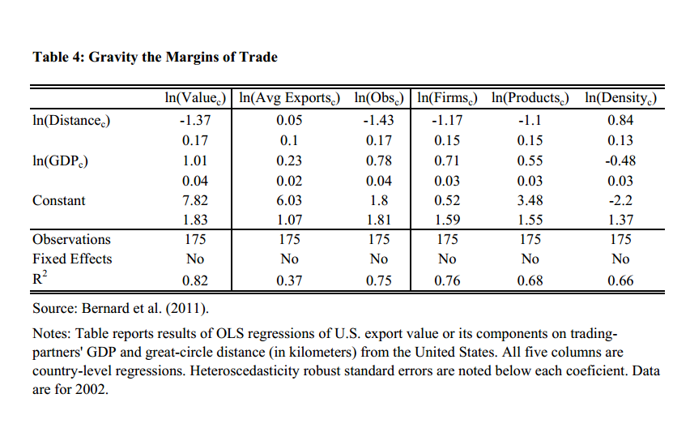
Gravity and the Margins of Trade Bernard, Redding and Schott (2011)
Extensive margin
The well-known negative effect of distance on aggregate bilateral trade is accounted for entirely by the extensive margin…
…and driven by selection across firms and products

Slide 68
New Empirical Frontiers
Frontier 1: Multiple product firms
Frontier 2: Product quality
Frontier 3: Intermediaries
Frontier 4: Firm export market dynamics

Slide 69
Product Quality Empirical Frontier #2
As with firms, there is tremendous heterogeneity across exports even within highly disaggregated Harmonized System product categories (there are ~20,000 HS products in U.S. import data)
This heterogeneity is easiest to see in prices (unit values)

Slide 70
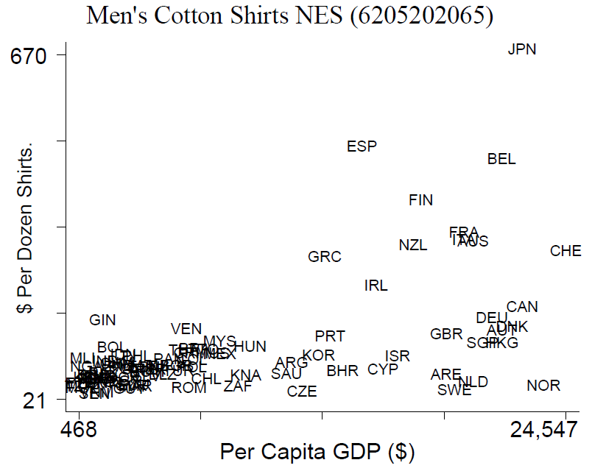
Price Variation Within Products in U.S. Import Data Schott 2004

Slide 71
High- and Low-Wage Country Exports Increasingly Overlap Schott 2004
Share of All U.S. Import Products
Share of All U.S. Import Value
Both High-and Low-Wage
Both
High-Wage Source
High
Low-Wage Source
Low

Slide 72
China’s Export Similarity with the OECD Schott 2004
1972 |  | 1983 |  | 1994 |  | 2005
Mexico | 0.18 | Mexico | 0.20 | Mexico | 0.28 | Korea | 0.33
Brazil | 0.15 | Korea | 0.18 | Korea | 0.25 | Mexico | 0.33
Taiwan | 0.14 | Taiwan | 0.17 | Taiwan | 0.22 | Taiwan | 0.22
Israel | 0.11 | Israel | 0.16 | Brazil | 0.19 | China | 0.21
Korea | 0.11 | Brazil | 0.16 | Hong Kong | 0.17 | Brazil | 0.20
Argentina | 0.11 | Hong Kong | 0.13 | Singapore | 0.16 | Poland | 0.17
Hong Kong | 0.11 | Singapore | 0.13 | China | 0.15 | Israel | 0.17
Czech Rep | 0.10 | Argentina | 0.09 | Malaysia | 0.15 | India | 0.16
Poland | 0.10 | Yugoslavia | 0.09 | Israel | 0.14 | Singapore | 0.15
Yugoslavia | 0.10 | Hungary | 0.08 | Thailand | 0.14 | Hong Kong | 0.15
Colombia | 0.07 | Poland | 0.08 | Argentina | 0.09 | Thailand | 0.15
South Africa | 0.07 | Saudi Arabia | 0.08 | Poland | 0.09 | Argentina | 0.13
Venezuela | 0.06 | China | 0.08 | India | 0.09 | Hungary | 0.13
Singapore | 0.06 | South Africa | 0.07 | Philippines | 0.08 | Malaysia | 0.11
Hungary | 0.05 | Neth Antilles | 0.07 | Venezuela | 0.08 | Indonesia | 0.11
Romania | 0.05 | India | 0.07 | Hungary | 0.07 | Philippines | 0.10
Cyprus | 0.05 | Philippines | 0.07 | Indonesia | 0.07 | South Africa | 0.10
Gibraltar | 0.05 | Panama | 0.06 | South Africa | 0.07 | Panama | 0.09
China | 0.05 | Thailand | 0.06 | Bermuda | 0.06 | Romania | 0.08
India | 0.05 | Colombia | 0.06 | Colombia | 0.06 | Colombia | 0.08
Source: Schott (2008). The ESI is from Finger and Kreinin (1979): ESI_{cd} = Σ_{p} min(s_{pc}, s_{pd}), where s is the export share of product p in country c.

Slide 73
China’s “Unit Value” Dissimilarity With the OECD Schott (2008)
China’s unit value discounts are persistent and contrast starkly with its increasing product-mix overlap

Slide 74
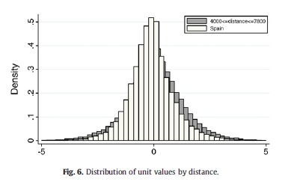
Prices Vary Across Firms As Well Bastos and Silva (2010)
Two distributions of Portuguese firm-product export unit values
The farther the shipment, the higher the price
To Spain
To destinations 4000-7800km away

Slide 75
Does Quality Matter?
Crozet, Head and Mayer 2011 study variation in quality across French wine exporters, and find that prices, the probability of market entry and export values all increase with quality
Hausmann, Hwang and Rodrik (2006) suggest that countries’ “ability” to climb the quality ladder may influence subsequent growth
Verhoogen (2008) suggests that firms’ quality upgrading may have implications for wage inequality, as product quality is derived in part from worker quality
etc…

Slide 76
New Empirical Frontiers
Frontier 1: Multiple product firms
Frontier 2: Product quality
Frontier 3: Intermediaries
Frontier 4: Firm export market dynamics

Slide 77
Intermediaries Frontiers of Empirical Research #3
Intermediaries play a large but not-well-understood role in international trade
Bernard et al. (2010) decompose U.S. importers and exporters according to their wholesale and retail employment
Pure Wholesalers and Retailers
Mostly Wholesalers and Retailers
Mostly Not Wholesalers and Retailers
No Wholesaler or Retailer

Slide 78
Intermediaries Bernard, Jensen, Redding and Schott 2010
 | Exporting Firms |  |  |  | Importing Firms
Firm Type | %Firms | %Value | %China Value |  | %Firms | %Value | %China Value
Pure Wholesale or Retail | 43 | 9 | 53 |  | 55 | 17 | 71
Mostly Wholesale or Retail | 1 | 2 | 11 |  | 1 | 8 | 18
Mostly Not Wholesale or Retail | 4 | 67 | 60 |  | 4 | 55 | 55
No Wholesale or Retail | 52 | 22 | 58 |  | 40 | 21 | 56
Notes: Firms are classified according to employment shares across establishments.

Slide 79
Intermediaries Bernard, Jensen, Redding and Schott 2010
 | Exporting Firms |  |  |  | Importing Firms
Firm Type | %Firms | %Value | %China Value |  | %Firms | %Value | %China Value
Pure Wholesale or Retail | 43 | 9 | 53 |  | 55 | 17 | 71
Mostly Wholesale or Retail | 1 | 2 | 11 |  | 1 | 8 | 18
Mostly Not Wholesale or Retail | 4 | 67 | 60 |  | 4 | 55 | 55
No Wholesale or Retail | 52 | 22 | 58 |  | 40 | 21 | 56
Notes: Firms are classified according to employment shares across establishments.

Slide 80
Intermediaries Bernard, Jensen, Redding and Schott 2010
 | Exporting Firms |  |  |  | Importing Firms
Firm Type | %Firms | %Value | %China Value |  | %Firms | %Value | %China Value
Pure Wholesale or Retail | 43 | 9 | 53 |  | 55 | 17 | 71
Mostly Wholesale or Retail | 1 | 2 | 11 |  | 1 | 8 | 18
Mostly Not Wholesale or Retail | 4 | 67 | 60 |  | 4 | 55 | 55
No Wholesale or Retail | 52 | 22 | 58 |  | 40 | 21 | 56
Notes: Firms are classified according to employment shares across establishments.
Recent efforts to model intermediaries and trade help to open the “black box” of trade costs, increasing our understanding of how lower-productivity firms might gain access to foreign markets
E.g., Ahn et al. (2011) and Blum et al. (2011)

Slide 81
Intermediaries Bernard, Jensen, Redding and Schott 2010
 | Exporting Firms |  |  |  | Importing Firms
Firm Type | %Firms | %Value | %China Value |  | %Firms | %Value | %China Value
Pure Wholesale or Retail | 43 | 9 | 53 |  | 55 | 17 | 71
Mostly Wholesale or Retail | 1 | 2 | 11 |  | 1 | 8 | 18
Mostly Not Wholesale or Retail | 4 | 67 | 60 |  | 4 | 55 | 55
No Wholesale or Retail | 52 | 22 | 58 |  | 40 | 21 | 56
Notes: Firms are classified according to employment shares across establishments.
Recent efforts to model intermediaries and trade help to open the “black box” of trade costs, increasing our understanding of how lower-productivity firms might gain access to foreign markets
E.g., Ahn et al. (2011) and Blum et al. (2011)

Slide 82
New Empirical Frontiers
Frontier 1: Multiple product firms
Frontier 2: Product quality
Frontier 3: Intermediaries
Frontier 4: Firm export market dynamics

Slide 83
Firm Export Market Dynamics Frontiers of Empirical Research #4
Eaton et al. (2009) study Colombian firms’ entry and exit from export markets over time
In a typical year, 1/3-1/2 of all exporters are new entrants
New entrants are typically small and the majority exit within a year
Conditional on survival, new exporters grow rapidly and subsequently account for a substantial proportion export growth

Slide 84
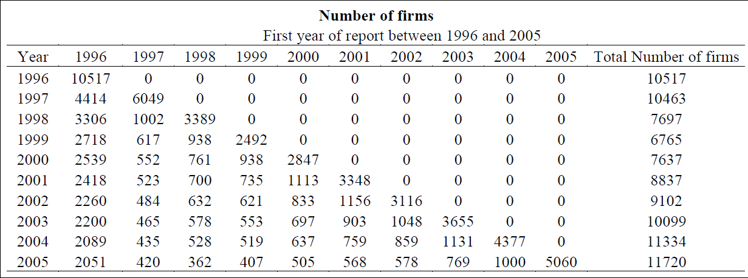
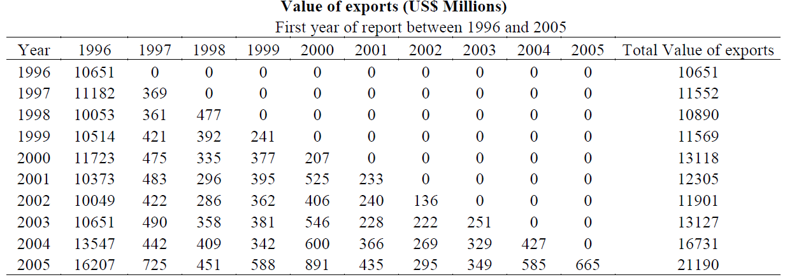
Dynamics of Firm Entry into Exporting

Slide 85
Dynamics of Firm Entry into Exporting

Slide 86
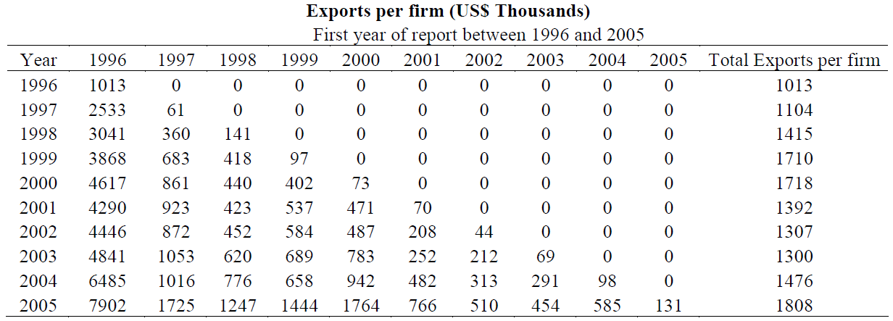
Dynamics of Firm Entry into Exporting

Slide 87
Firm Export Market Dynamics Frontiers of Empirical Research #4
Examination of entry/exit dynamics promotes understanding of the sunk costs of exporting, and the extent to which they are tied to
Becoming an exporter
Exporting to a particular destination
Exporting a particular product to a particular destination
More generally, this research promotes understanding of
How firms “learn” about exporting
Eaton et al. (2011), Akhmetova (2011), Albornoz et al. (2011) and Segura-Cayuela and Vilarrubia (2008)
How firms respond to productivity shocks in their destination markets
Bernard et al. (2009), Arkolakis (2011) and Ruhl and Willis (2011)

Slide 88
Conclusion
We could go on to discuss…
Intra-firm trade
Pricing
FDI
Heterogenous labor reallocation among heterogeneous firms
etc.
What are you all working on?

Slide 89
Conclusion
Data
i
Theory
i
Data
i
Theory
i
Data
i
Theory
.
.
.

Slide 90
Thanks!

